Slide 1
Technical Data Reporting Implementation
February 2021

Slide 2

Technical Data Overview
Technical Data…
Cost data has been delivered on DoD contracts for 60 years, SW data has been provided for 10 years. Technical Data has always been a requirement; however, not implemented effectively
Tech Data initiative:
Provides mechanism to systematically capture Tech Data on contracts
Complements DoD CARD process
Creates a common Tech Data Vocabulary
Defines core set of needed parameters
Leverages other Tech Data on contract
Results:
Tech Data Plan reported via WBS
Common taxonomy for both CARD and TDR - consistent with GOVT ENGR groups and Industry
Enduring Cost Analysis Need
Provides context to the cost data
Defines the Program’s Technical Baseline
Ingredient of acquisition strategies, e.g., schedules
Identification and quantification of cost drivers
Foundation for Independent Technical Assessments
Supports architecture trade studies
Highlights areas of potential risk
Unfortunately Tech Data is a Knowledge Gap
Technical Data has always been a requirement; however, not implemented effectively
Data collections have been ad-hoc, inefficient, and random within DoD
  Program documents contain lots of narrative and not enough real data
Result: We re-construct Technical analogies for nearly every estimate
DoD now has Contractual Mechanism and Process to Collect Technical Data

Slide 3
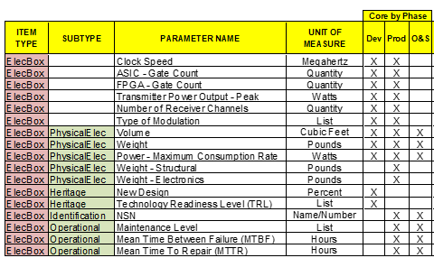
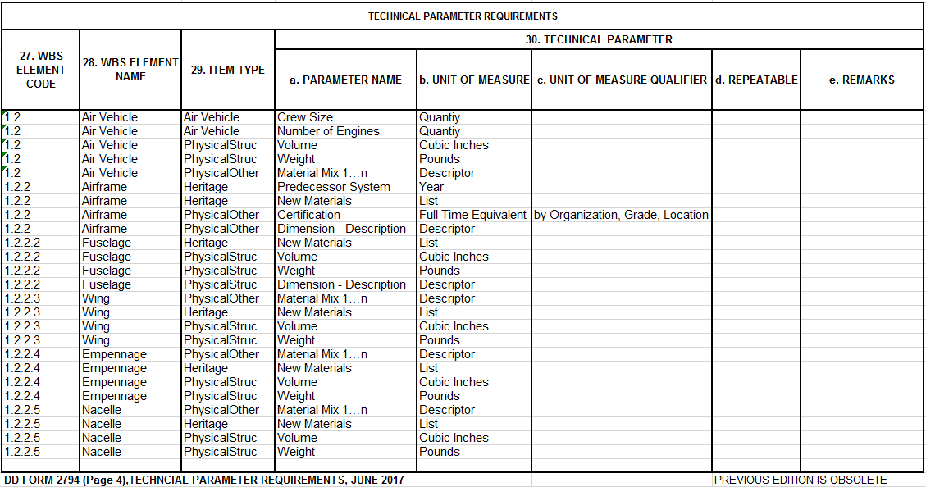
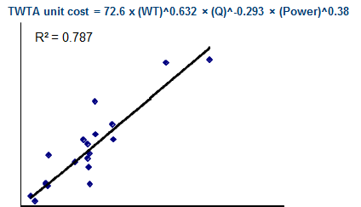
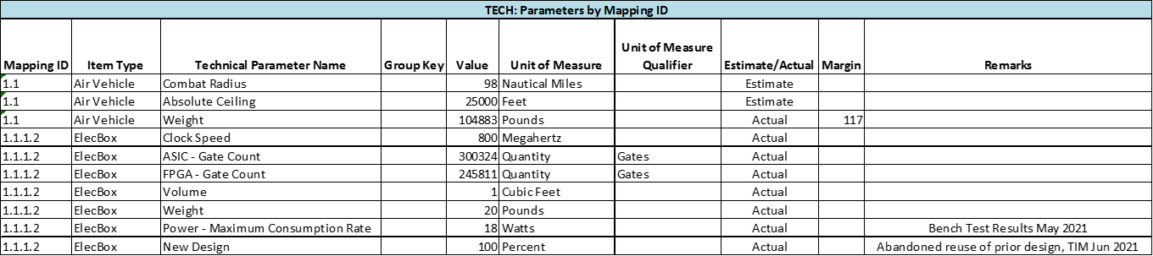
Technical Data Reporting Implementation
Repeatable Tech Data Process
Start with Core Parameters by Commodity & Phase
Refine Contract-Specific Parameters using Technical Data Vocabulary Database
Review other Contractual CDRL Requirements to Minimize Duplication
Finalize Technical Data Reporting, DD 2794 Supplement & Submission Events
Revise generic Technical Data CDRL (DD 1423) to Program specifics
Participate in pre / post award conferences to Ensure Tech Data requirements are well understood
Standard CSDR Plans and CADE Technical Vocabulary
Contract CSDR Plan Technical Data Supplement
Data-rich CADE Repository
Contractor Reports technical data by WBS element per plan
Contractor TDR Submission
Future Analysis
Over time, CADE cost data usefulness will be significantly enhanced

Slide 4
Technical Data Collection
How Do We Get the Requirement on Contract?

Slide 5
Technical Data Reporting Implementation
Advocacy for Technical Data Reporting
Technical data is an enduring cost analysis need
Technical data will add value to the cost data collected for this contract
Estimating subsequent contracts on this program will use this technical data
Estimating future programs using this program as a reference will use this technical data
Obtaining technical data now as a contract deliverable avoids subsequent data calls to the contractor or program office
The Service Cost Center analyst is the voice of advocacy within the CWIPT for placing the Technical Data Report on contract

Slide 6
Technical Data Reporting Implementation
CWIPT Implementation Checklist
Start with Core Parameters by Commodity & Phase
Refine Contract-Specific Parameters using Technical Data Vocabulary Database
Review other Contractual CDRL Requirements to Minimize Duplication
Finalize Technical Data Reporting, DD 2794 Supplement & Submission Events
Revise generic Technical Data CDRL (DD 1423) to Program specifics
Participate in pre / post award conferences to Ensure Tech Data requirements are well understood
CWIPT must always start with Core Parameter templates by Commodity and Phase

Slide 7
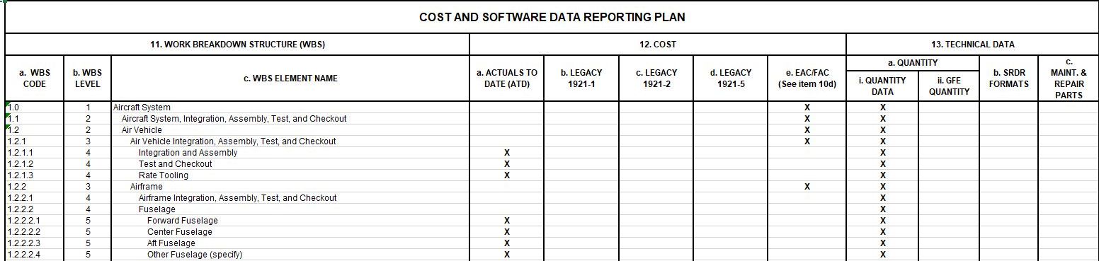
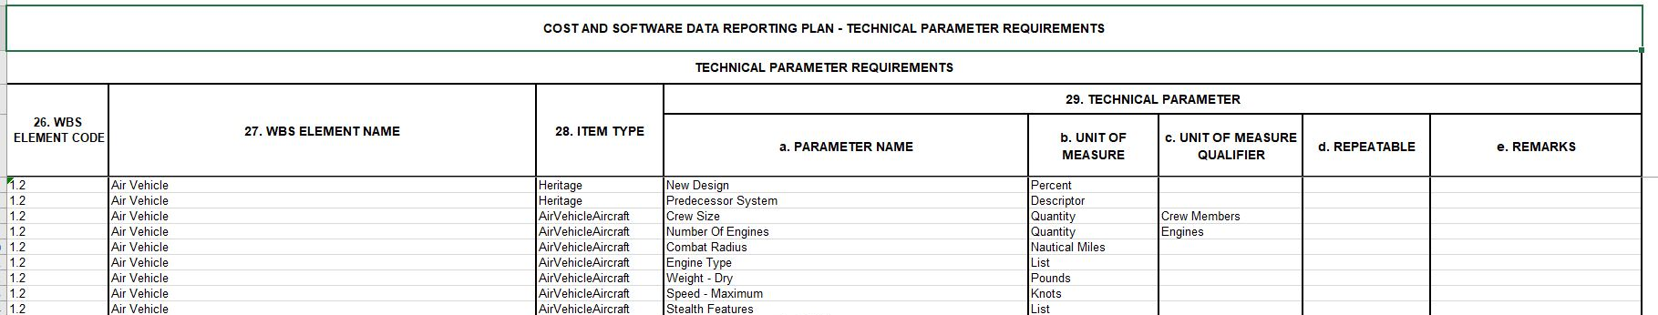
Technical Data Webinar
How Do We Collect Technical Data
Start with WBS Structure DD2794
Start with WBS Structure to determine which parameters to place on contract

Slide 8
Technical Data Webinar
How Do We Collect Technical Data
Use the Core Parameters by Commodity & Phase
From Commodity Data Templates, we developed “core” parameters based on the following criteria:
  Absolutely Required to Perform Cost Analysis
  Typically not Produced by Govt Team
  Normally Produced by Industry
  Segregated by each Commodity
  Changes throughout the evolution of a Program
Core Parameters are useful starting place when attempting to create a Technical Data Supplement
Commodity Standard Templates
MIL-STD
881WBS
Core Parameters
CWIPT Process

Slide 9
Technical Data Reporting Implementation
CSDR Standard Plans, a Good Starting Point
Extending MIL STD 881E
Individual Standard Plan WBS Product Extensions:
  Serve as the starting point for weapon system and defense business system program CWIPTs CSDR Contract and Subcontract Planning
    WBS extensions provide the capability to capture high-cost, high-risk, advanced technology components as defined by the CWIPT and refined by industry feedback
    Serve as a starting point for building the Contract/Subcontract plans tied to company’s contract scope of work
    Facilitates effective and early communication of Government expectations for cost/technical/programmatic data collection with industry via CSDR CDRLs
    Starting point for technical data collection and basis of the Technical Data Vocab Core Parameters
MIL STD
“…consistent and visible framework …”
“…consistent application of the WBS for all programmatic needs (including performance, cost, schedule, risk, budget, and contractual).”
“…tailoring may occur …”
“An effective WBS … has a logical structure and is tailored to a particular defense materiel item. ”
Update cycle > 5 years
MIL-STD-881D 2018
MIL-STD-881C 2011
MIL-HDBK-881A 2005
MIL-HDBK-881 1998
MIL-STD-881B 1993
MIL-STD-881A 1975
MIL-STD-881 1968
A Aircraft
Aircraft
UAV
B Electronic or Generic
Electronic Warfare
Avionics
C4I Electronics
Radar
Engine
Generic Subcontractor
C Missile/Ordnance
Missile
D Strategic Missile
Strategic Missile
E Sea
Ship
F Space
Space
G Ground Vehicle
Ground Vehicle
H Unmanned Maritime
UUV
I Launch Vehicle
Launch Services
Product Extensions
Repeatable
Predictable
Modular
Collaboration Framework
Tailor-able by Phase
Update cycle as needed
Launch Service
Launch Service Support
Launch Service Support
J Information/Defense Business
IS/DBS
Ground Segment for Space or UAVs
K Common Elements
L Sustainment
Sustainment
881E Appendices
Modifications
Implementation
Guidance only
AFCAA
OGC Flight Test
Not AFCAA
Applicable to
Edwards AFB only
Not 881
Training Systems

Slide 10
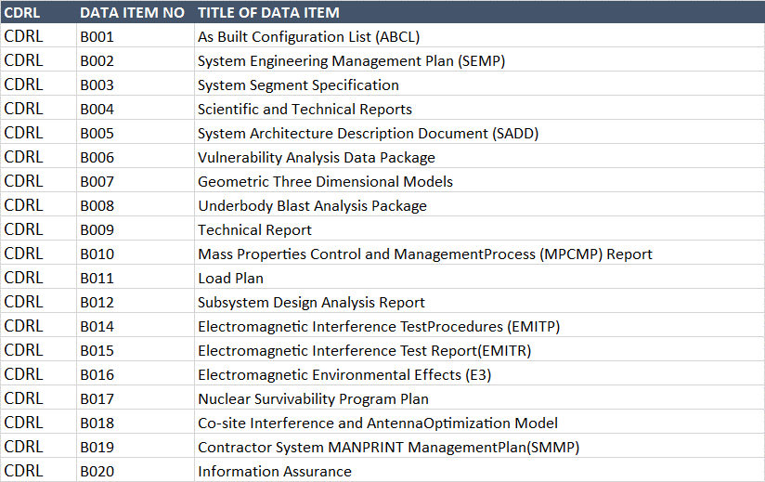
Technical Data Reporting Implementation
Minimize Duplication of Deliveries
Review other Contractual CDRL Requirements to Minimize Duplication
Applicable Data Items
  DI-MGMT-81650 IMS
  DI-GDRQ-81230 Mass props Status report
  DI-GDRQ-81223 Schematic Block Diagram
  DI-QCIC-80553A Acceptance test plan
  DI-ADMN-81373 Presentation Material PDR Reports
  DI-ADMN-81373 Presentation Material CDR Reports
Other Technical Data required
  Specifications
  System Description document
  Technical Description document
Produced by
Industry Today
If other CDRLs are identified, ensure that CDRL language reflects delivery to CADE, along with Technical Data Report

Slide 11
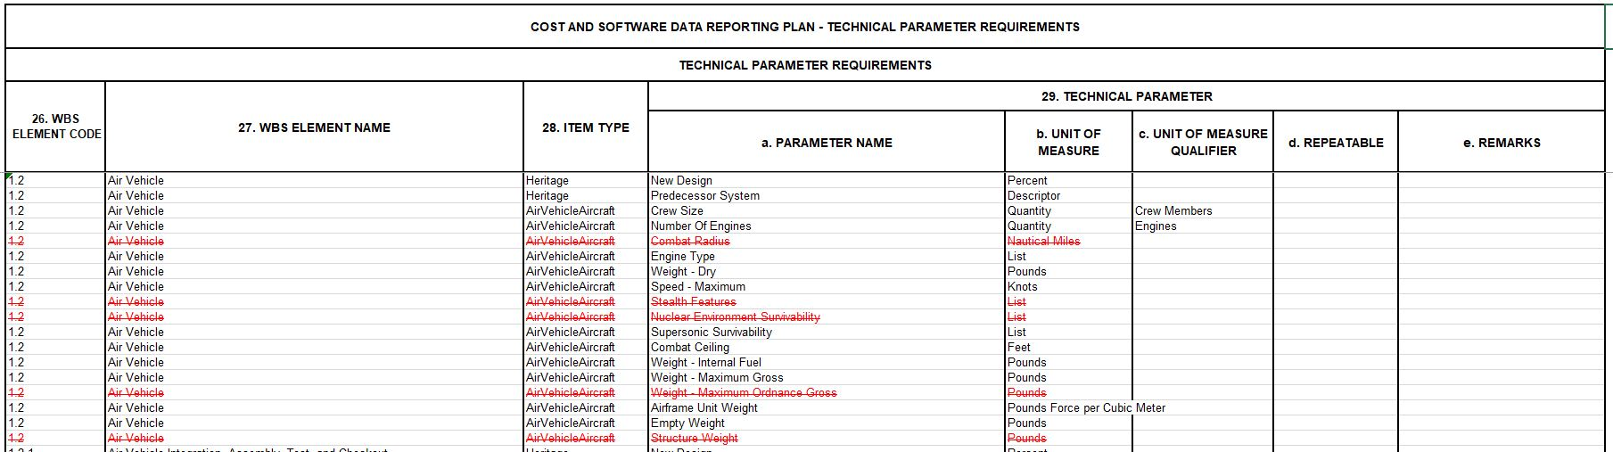
Technical Data Webinar
How Do We Collect Technical Data
Refine Contract-Specific Parameters using Technical Data Vocabulary Database
CWIPT process will derive contract data plan and analyze the following questions regarding the Parameters
  Can the requirement be satisfied by GOVT CARD?
  Can the requirement be satisfied by other Program CDRL?
  Can the requirement be satisfied by other reputable data sources?

Slide 12
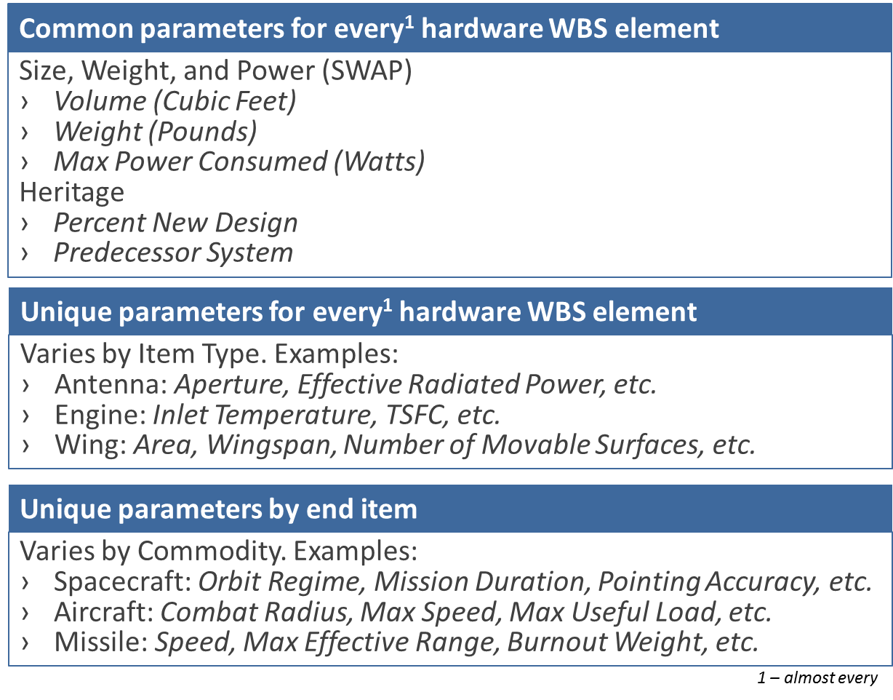
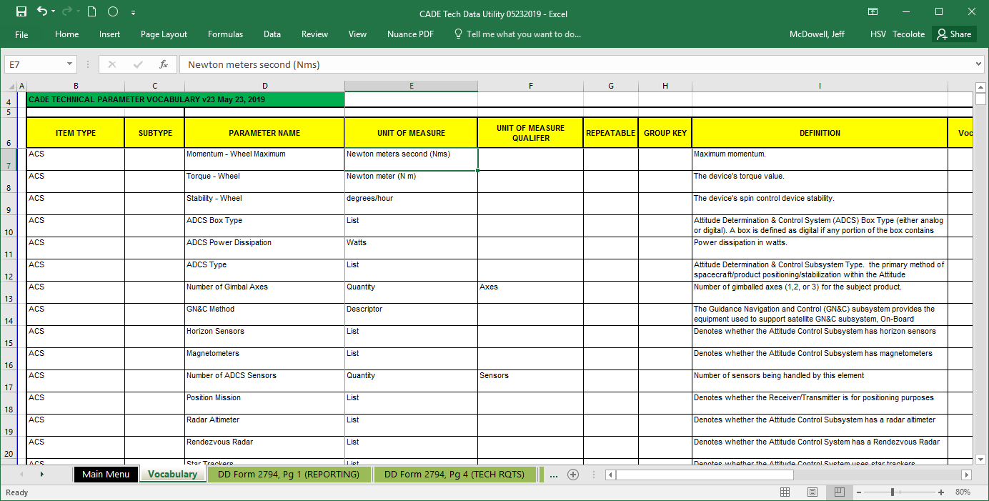
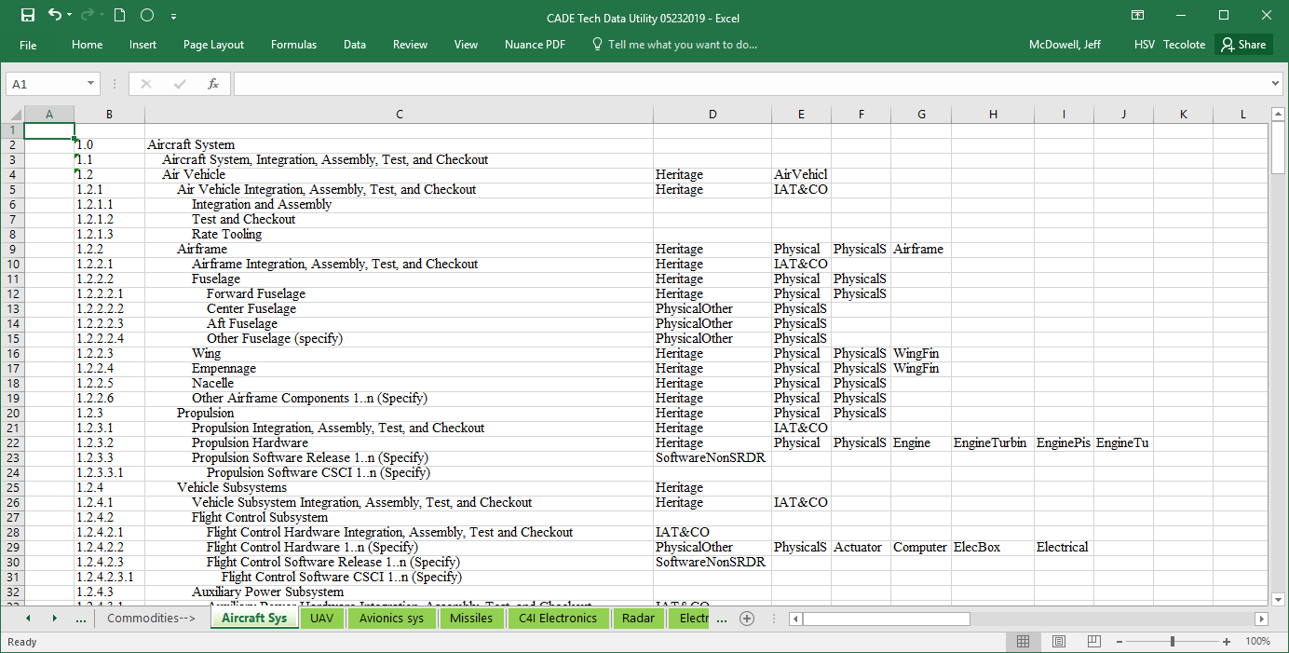
Technical Data Reporting Implementation
What is the Technical Vocabulary
The CADE Technical Vocabulary is comprised of two parts.
A glossary of parameter names, units, and definitions organized by Item Type
Commodity Work Breakdown Structures with associated Item Types
Optional: Open the Vocab Utility Workbook in Excel
Item Type
Parameter Name
CSDR Standard Plan WBS
Item Types
Vocabulary Sheet
Commodity WBS Sheets

Slide 13
Technical Data Reporting Implementation
Technical Data Plan Example
*The final Technical Data Plan put on contract may look vastly different from the initial plan generated due to the CWIPT process

Slide 14
Technical Data Reporting Implementation
Technical Data Report Submission Example
* The Technical Data Report is the ideal format, in order to be less burdensome to the contractor the CWIPT is willing to accept alternative formats for Technical Data submissions with those formats still tying Technical Data to the WBS Element

Slide 15
Technical Data Reporting Implementation
Technical Data Submission Events
When Will the Cost Community Collect Technical Data?
Event 1 CDR
Event 2 First Delivery
Event 3 Contract End
Event 1
Lot 1 Delivery
(Contract End)
Event 1
Year 1 Complete
Event 2
Year 2 Complete
Development
Lot 1
Production
Lot 2
Lot 3
CLS Year 1 Europe
Sustainment
CLS Year 2 Europe
CLS Year 2 CONUS
For additional information, see:
DD 2794 Overview
TDR Submission Events and Frequency Varies by Life Cycle Phase

Slide 16
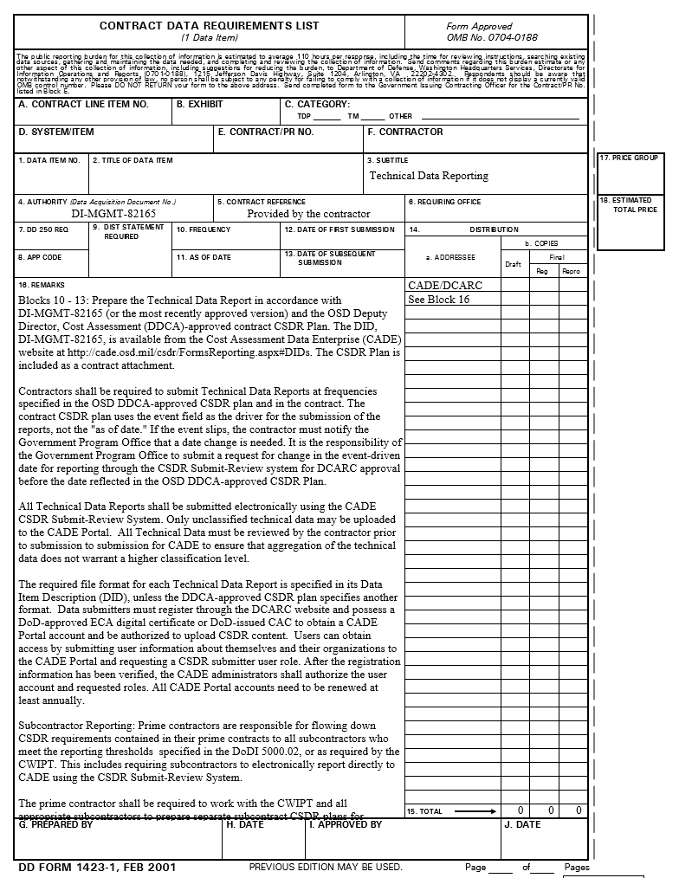
Technical Data Reporting Implementation
Technical Data Reporting Supplement
Revise generic Technical Data CDRL (DD 1423) to Program specifics
Technical Data Report example CDRL language can be downloaded at https://cade.osd.mil/policy/cdrl
CDRL language should always refer to the CSDR Plan for technical data parameter requirements by WBS element
In cases where other CDRLs meet the requirements for technical data parameter, but are not explicitly reported on the TDR, the CDRL language should specify the following:
  Any alternative CDRL identified through the CWIPT process that meets the requirements for technical parameter reporting should be submitted to CADE along with the TDR for each required submission event, as specified in Block 15 (CSDR Submission Events)

Slide 17
Technical Data Reporting Implementation
Technical Data Reporting Supplement
Participate in pre/post award conferences to Ensure Tech Data requirements are well understood
Pre/Post Award discussions with industry can cover the following topics:
  Review of “Scope Definition: Order/Lots/End Items” (DD 2794 Items 17, 18, 19)
    Ensure that industry understands the desired breakout of Delivery Orders, Lots, Builds, as well as all applicable Variant or End Item reporting
    Ties to the TDR requirement for “Mapping ID” to tie the reported technical parameter to applicable WBS, Lot, and End Item
  Review “Submission Events” (DD 2794, Item 15)
    Ensure industry understands frequency of reporting
    Discuss the evolution of parameter values from Estimates to Actuals over the lifecycle of the contract/program
  Review availability of desired parameters listed in the Technical Data Supplement (DD 2794, Items 27-30)
    Ensure industry can report parameter values according to WBS element
    Allow contractor to identify other CDRLs that may meet reporting requirements
    Ensure that other CDRLs that meet the TDR requirements are submitted along with the TDR in CADE
    Review security or classification concerns
  If required, submit a revised Technical Data Supplement to the DCARC, along with revised plan for review and approval

Slide 18
Technical Data Reporting Implementation
Additional Considerations
SRDR Reporting:
  If SRDR Development, Maintenance, or ERP reporting is required for the contract, ensure that the Technical Data Reporting parameters do not duplicate SRDR DID reporting requirements
  If SRDR Development, Maintenance, or ERP reporting is NOT required, the Technical Data Reporting parameters allow for some software parameters to be included as reporting requirements
Sustainment & Contractor Logistics Support (CLS) Reporting:
  When Maintenance and Repair Reporting is planned, plan the Technical Data Report to capture the fielded item(s) being supported such as fleet size and OpTempo by location
  Leverage the O&S phase Core parameter list to implement sustainment-specific parameters, such as quantities
  BOTH TDR and M/R are appropriate for a given contract plan
Legacy & FlexFile Reporting:
  The DD 2794 Technical Data Supplement can be added to contracts that require either 1921, legacy reporting requirements, OR FlexFiles
  Ensure the submission event tables reflect appropriate forms
For additional information, see:
Intersection with Other Reporting

Slide 19
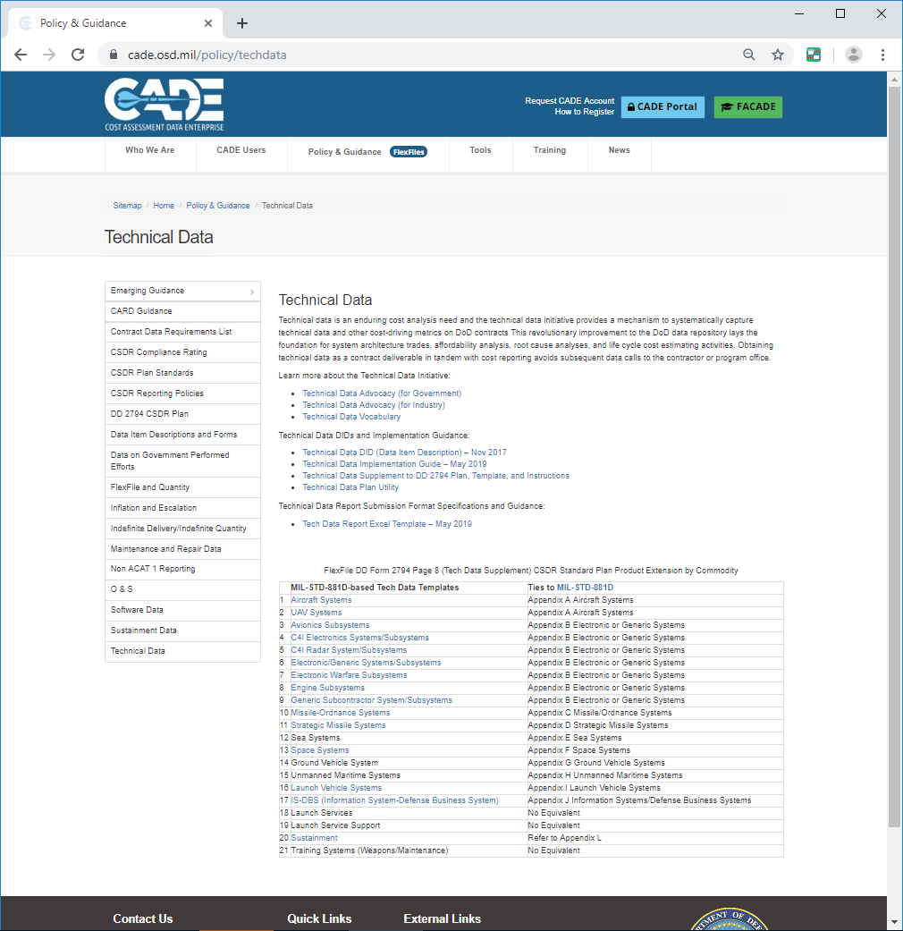
Technical Data Reporting Implementation
Tech Data on the CADE Public Site
Learn More
Implementation Guidance
Submission Guidance
Standard Tech Data Plans

Slide 20
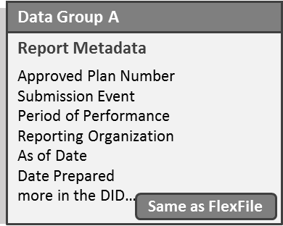
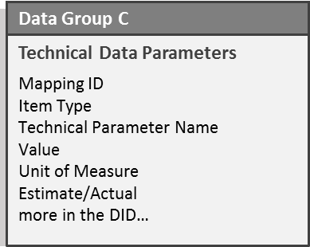
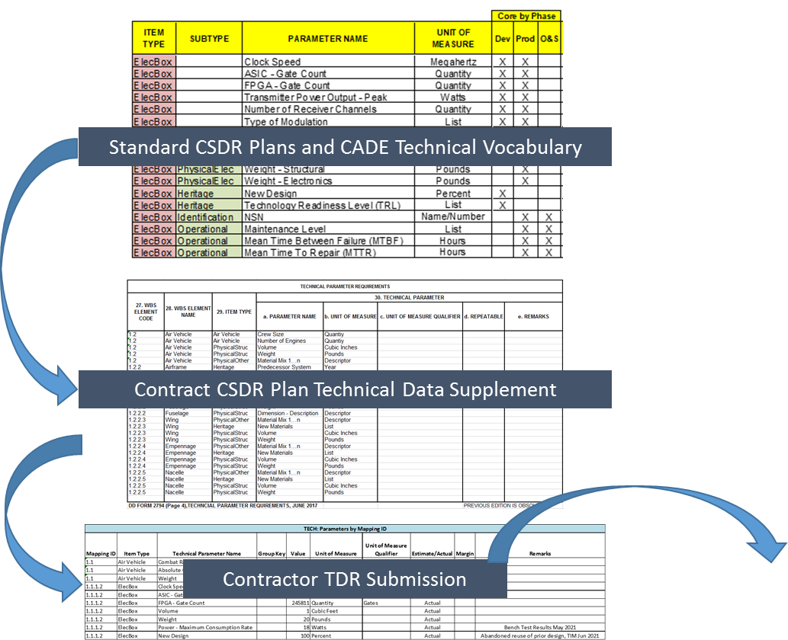
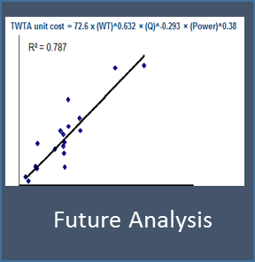
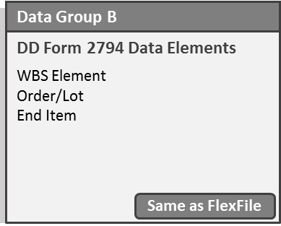
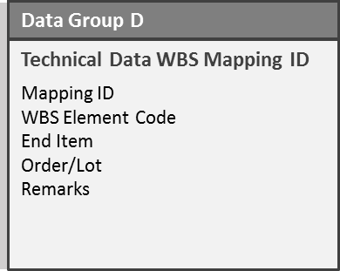
Technical Data Reporting Implementation
Conclusion
Tech Data has it’s DID
Tech Data has a
data model
Tech Data has
process
Most of all, Tech Data has
purpose
Tech Data is positioned to meaningfully contribute to a
data-rich CADE repository

Slide 21
Technical Data Reporting
Frequently Asked Questions (FAQs)

Slide 22
Technical Data Reporting Implementation
Frequently Asked Questions & Responses
Why Does Cost Community Need Technical Data?
Defines the Program’s Technical & Programmatic Baseline
Foundation for Independent Technical Assessments
Supports architecture trade studies
Highlights areas of potential risk
Backbone for Affordability Modeling
Identification and quantification of cost drivers
Permits assessment of Program A vs. Program B complexity
  Critical to analogy estimating
  Fine tunes parametric estimates

Slide 23
Technical Data Reporting Implementation
Frequently Asked Questions & Responses
Doesn’t the CARD provide the requisite Tech Data?
CARDs are a product of the Program Office, whereas the TDR is a contract CDRL
The TDR typically pertains to only the immediate contract content whereas the CARD is forward looking and pertains to the whole program life cycle
The Technical Data Vocabulary Database organizes the parameters by data provider; either government or industry
The CARD is a living document, updated on an annual basis, and serves as the authoritative source for all programmatic technical data:
  Parameters provided by the government are tagged as such in the “Source” column
  Parameters provided by industry via the TDR and other CDRLs are added to the eCARD tables, and documented as industry-provided in the “Source” column

Slide 24
Technical Data Reporting Implementation
Frequently Asked Questions & Responses
Why Can’t I get Technical Data from Other Contract Data?
Cost Community does not own the requirement, hence it can get removed / tailored from contract
There is no consistent (standard) set of Tech Data required for every contract
There is no central repository of Tech Data by contract
There is not always consistent definition of terms used for Tech Data
Deliveries of other Tech Data via contract may not be timely to support estimating needs
How can I ensure the Technical Data requirement can be satisfied by Industry?
The CWIPTs responsibility is to account of the availability of the contractor’s technical data
The Program Office should take advantage of the Post Award Conference to review the list of technical parameters with industry to ensure availability of the data, the connection to the WBS, and to minimize the duplication of reported parameters across other CDRLs
What about Industry Technical Data Rights, Security Concerns?
The TDR should be reviewed and approved by the security officer prior to submission into CADE to ensure that there is no classified data, or aggregation of unclassified data that would cause the TDR to be classified

Slide 25
BACKUP:
Technical Data Reporting Resources

Slide 26
Technical Data Reporting Implementation
Technical Data Reporting Resources
Tips and Tricks for Selecting Technical Parameters
Focused Tailoring of Technical Data Plans Using the Tech Data Utility
Tips and Tricks for Planning Process in the CADE System
Technical Data Reporting Implementation Intersection With Other Reporting
Technical Data Vocabulary Utility Introduction and Overview
Technical Data Reporting Implementation DD 2794 Overview
Technical Data Reporting Implementation Treatment of Variants
Technical Data Reporting Implementation Planning, Tailoring, and Reporting Using Temporal Examples of Both CARD and TDR
Technical Data Reporting Implementation Treatment of Margin and Data Pedigree

Slide 27
Focused Tailoring of Technical Data Plans
Tips & Tricks for Selecting Technical Parameters

Slide 28
Tips & Tricks for Selecting Technical Parameters
Table of Contents
Selecting Parameters
  Development Contracts - Heritage
  Development Contracts - Software
  Hardware Products - SWAP
  Hardware Products - Unique parameters
  Sustainment
  Multiple Variants
  Modifications

Slide 29
Tips & Tricks for Selecting Technical Parameters
Design Heritage
Is this a development contract?
  If so, then future estimators will want design and development metrics to make full use of the CSDR’s nonrecurring cost.
For hardware WBS elements use heritage parameters:
  The magnitude of nonrecurring design and development effort will be influenced by the extent to which an existing design is modified. A pair of heritage parameters, New Design and Predecessor System, are available to capture this information.
  At what WBS level is heritage meaningful? The level at which nonrecurring engineering cost is captured is a best practice (e.g. every child element). If pressure to decrease the parameter count is present, consider placing heritage parameters on only the subsystem parent levels.
Heritage at child elements
Heritage at parent elements

Slide 30
Tips & Tricks for Selecting Technical Parameters
Size, Weight, and Power for Hardware Products
Does this contract produce hardware (production or development prototypes)?
  If so, then future estimators will want product characteristics to make full use of the CSDR’s recurring cost.
For hardware WBS elements use size, weight, and power (SWAP) parameters:
  Hardware costs are often influenced by SWAP parameters. Typically this is a minimum to obtain for every hardware child element. Three often-used parameters are: Use the subtype to get Weight, Volume, and Power – Maximum Consumption Rate.
  For structural and mechanical items, Power does not of course need not be listed.
  Structure costs are often influenced by material choices. When applicable also add Material Mix.

Slide 31
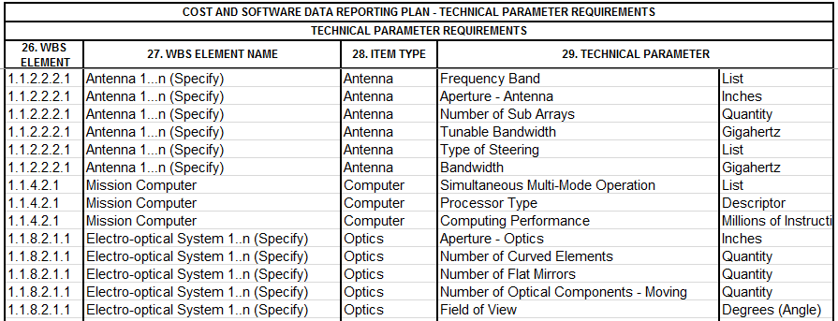
Tips & Tricks for Selecting Technical Parameters
Unique Parameters for Hardware Products
Does this contract produce hardware (production or development prototypes)?
  If so, then future estimators will want product characteristics to make full use of the CSDR’s recurring cost.
In addition to SWAP, many hardware production have unique characteristics
  Additional general-purpose parameters for specific products are available. A sample is shown below. Determine if there is a need for unique parameters for certain WBS elements. Further determine if these are most applicable at child or parent levels.

Slide 32
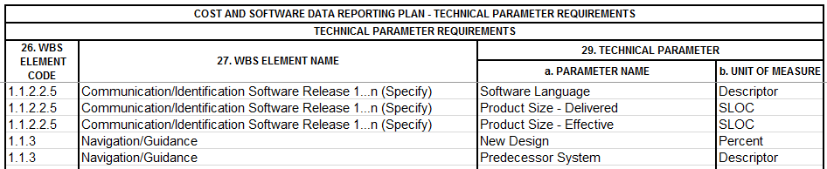
Tips & Tricks for Selecting Technical Parameters
Software Products
Is this a development contract with software effort?
  If so, then future estimators will want design and development metrics to make full use of the CSDR’s nonrecurring cost.
  If reporting thresholds are met*, then SRDR reporting is the best path to software metrics to make full use of the CSDR’s nonrecurring software cost. In the case, no technical characteristics are needed on the Software WBS elements. In the event that the contract has software effort that does not meet SRDR reporting thresholds, consider software technical data.

Slide 33
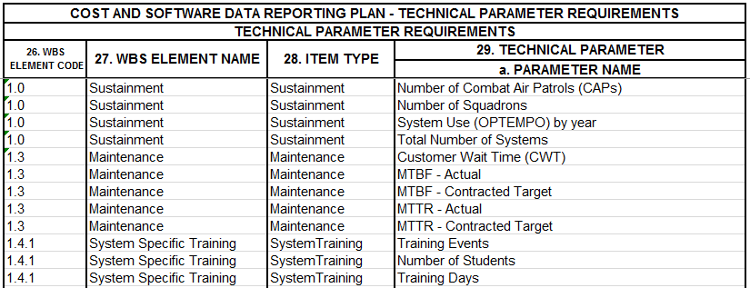
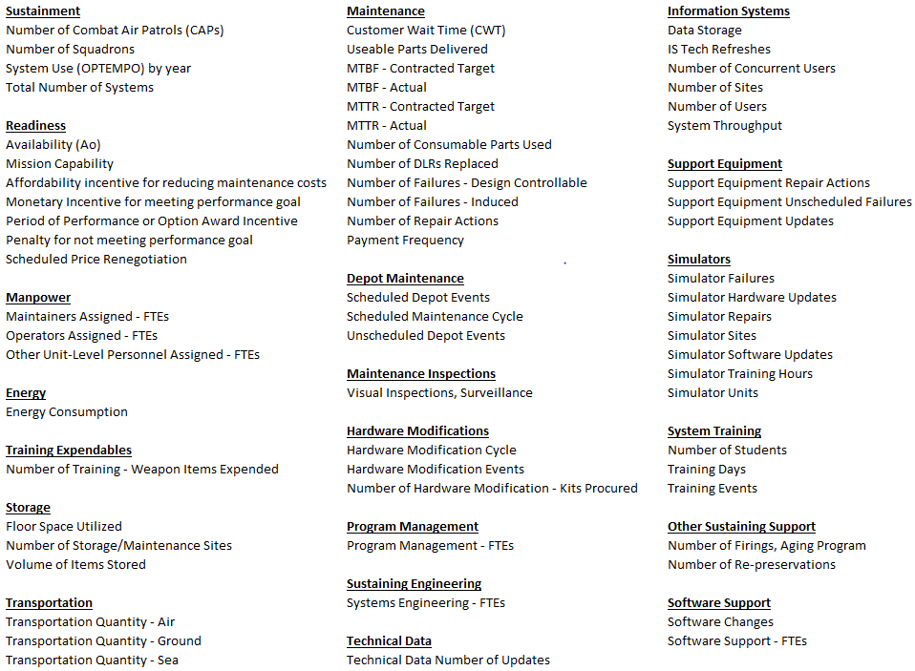
Tips & Tricks for Selecting Technical Parameters
Sustainment
Is this a sustainment contract?
  If so, then future estimators will want the inventory of systems supported, their operational tempo, and activity metrics on sustaining engineering, training, etc. to make full use of the CSDR’s cost.
What about the M/R report?
  When a significant portion of contract is maintenance activity, the plan may also require M/R reporting.
  The TDR and M/R are not interchangeable. While the M/R report captures of the cost of cumulative repair events, the TDR captures the footprint of systems supported plus other non-repair sustainment activity.

Slide 34
Tips & Tricks for Selecting Technical Parameters
Multiple Variants
Are multiple variants involved?
  If so, then future estimators will want product characteristics of each to make full use of the CSDR’s cost.
  The WBS may already have elements pertaining common and unique. In which case plan for technical data on each WBS element as in any other situation.
  If variants are not discernable within the WBS, use a Mapping ID comprised of variant, underscore, WBS code in the tech data plan.

Slide 35
Tips & Tricks for Selecting Technical Parameters
Modifications
Is this a modification contract?
  If so, then future estimators will want product characteristics of hardware added to the existing platform.
  The WBS should have elements pertaining to A-kits, B-kits, and installation labor.
  Use technical data to capture B-kits same as production hardware.…
  Consider Before/After tech parameters

Slide 36
Focused Tailoring of Technical Data Plans
Using the Tech Data Utility

Slide 37
Tips & Tricks for Selecting Technical Parameters
Table of Contents
Technical Data Utility
  Development Contracts - Heritage
  Development Contracts - Software
  Hardware Products - SWAP
  Hardware Products - Unique parameters

Slide 38
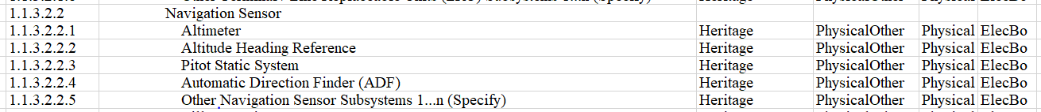
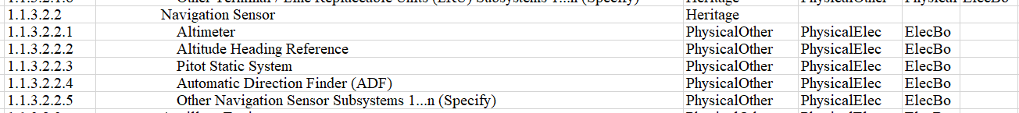
Tips & Tricks for Using the Tech Data Utility
Development Contracts - Heritage
Upon determining which WBS levels a need for design heritage:
  Direct edit the DD From 2794 Page 8 with the parameters on each desired WBS, or, better yet,
  Use the Tech Data Utility to assign the Heritage item type on each desired WBS, or, even better yet,
  Select an edit an applicable Standard Tech Data plan. Many of the standard plans have Heritage pre-populated at every child element, so delete the ones not deisted. (say ate every child elements.
  at every child WBS level consider putting it only at select parent level WBS elements
When using the Tech Data Utility:
  Enter the Heritage Item Type on the rows of the desired WBS elements
-OR-

Slide 39
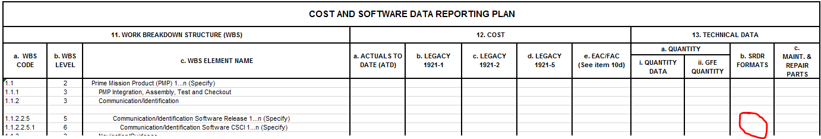
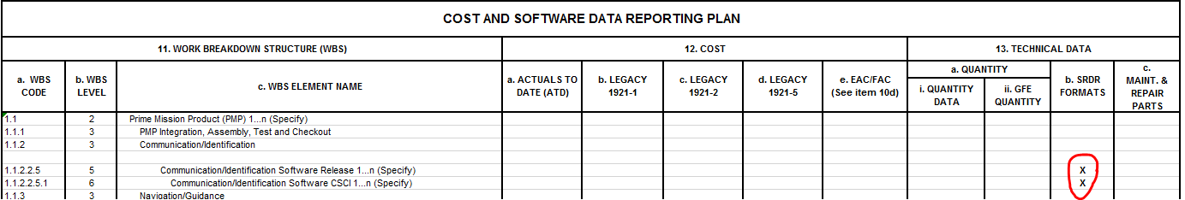
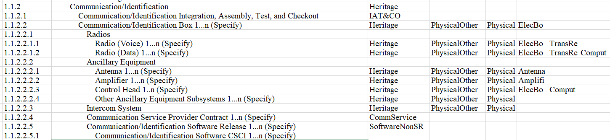
Tips & Tricks for Using the Tech Data Utility
Development Contracts - Software
If SRDR is a reporting requirement for a WBS Element, then make sure SRDR is a checked reporting requirement.
If SRDR is not a reporting requirement for a WBS Element, then verify SRDR is not checked on reporting requirements page. Then add SoftwareNonSRDR to the tech data plan.

Slide 40
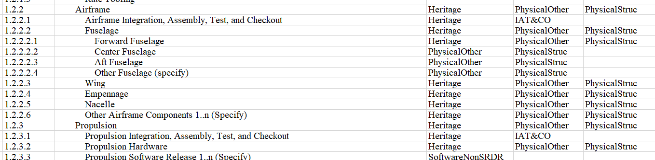
Tips & Tricks for Using the Tech Data Utility
Hardware Products - SWAP
If there is not a need for both PhyscialOther or PhysicalStruc consider only keep one item type that best reflects the WBS Element,
Consider what the WBS Element is asking for when considering SWAP Parameters

Slide 41
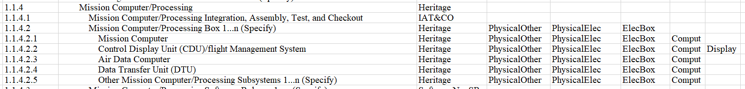
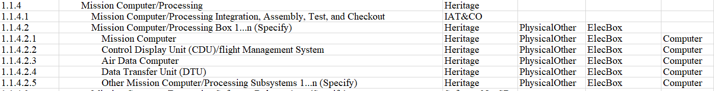
Tips & Tricks for Using the Tech Data Utility
Hardware Products - Unique Parameters
If there is not a need for PhysicalElec, ElecBoc, and Computer item types on one WBS Element consider narrowing the item types
Or if another unique parameter could be applicable, consider including that

Slide 42
Focused Tailoring of Technical Data Plans
Tips & Tricks for
Planning Process in the CADE System

Slide 43
Tips & Tricks for Planning Process in the CADE System
Table of Contents
  Utilize the Tech Data Utility
  Putting the DD2794 together
  Uploading in the PPM
  Posting into the CSDR-SR

Slide 44
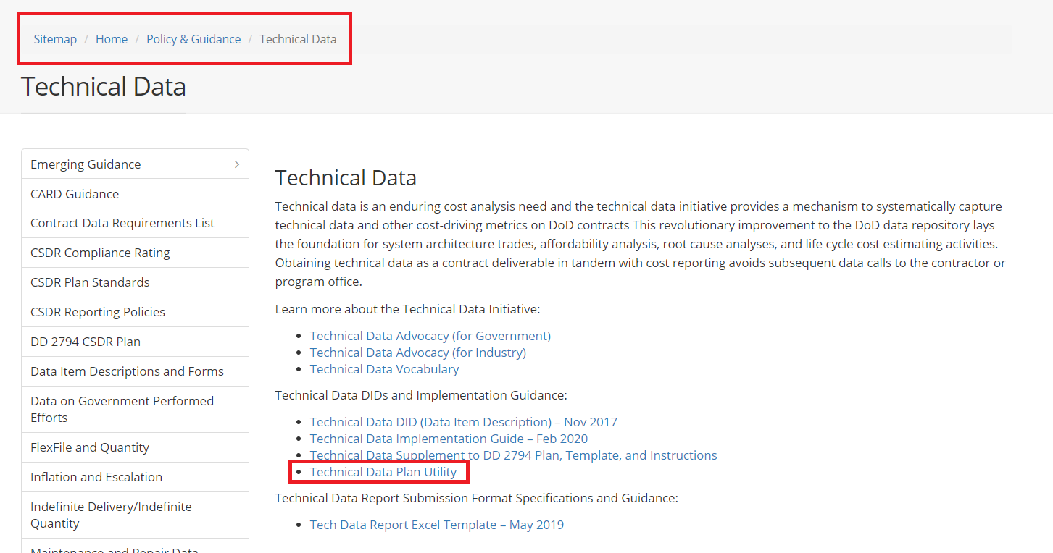
Tips & Tricks for Planning Process in the CADE System
Utilize the Tech Data Utility
  Download the Plan
    The PPM houses the plan
  Download the Tech Data Utility
    Public Site>Policy & Guidance> Technical Data

Slide 45
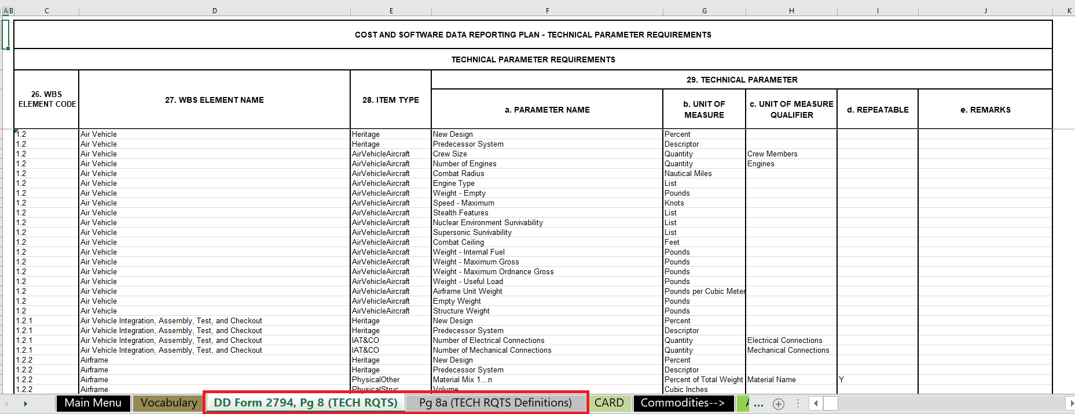
Tips & Tricks for Planning Process in the CADE System
Utilize the Tech Data Utility
  3. Use Utility to create (creating a more detailed guide for the utility so if there is any questions email courtney.a.clark21.ctr@mail.mil)
  1. DD Form 2794, Pg 8 (TECH RQTS)
  2. DD Form 2794, Pg 8a (TECH RQTS)

Slide 46
Tips & Tricks for Planning Process in the CADE System
Putting the DD2794 together
  The following pages can be updated and edited in cPet for DD2794
    DD Form 2794, Pg 1 (METADATA)
    DD Form 2794, Pg 2 (REPORTING)
    DD Form 2794, Pg 3 (EVENTS)
    DD Form 2794, Pg 4 (REMARKS)
    DD Form 2794, Pg 5 (SCOPE DEF)
    DD Form 2794, Pg 6 (SRDR DEV)
    DD Form 2794, Pg 7 (SRDR MX)
  When editing the DD2794 in cPet web or desktop for the pages listed above you can create the XML
  For Tech Data on the plan
    Add the following pages AFTER you have finished editing the plan in cPet
      DD Form 2794, Pg 8 (TECH RQTS)
      DD Form 2794, Pg 8a (TECH RQTS Definition)
    You must add the following pages to the Excel XLSX

Slide 47
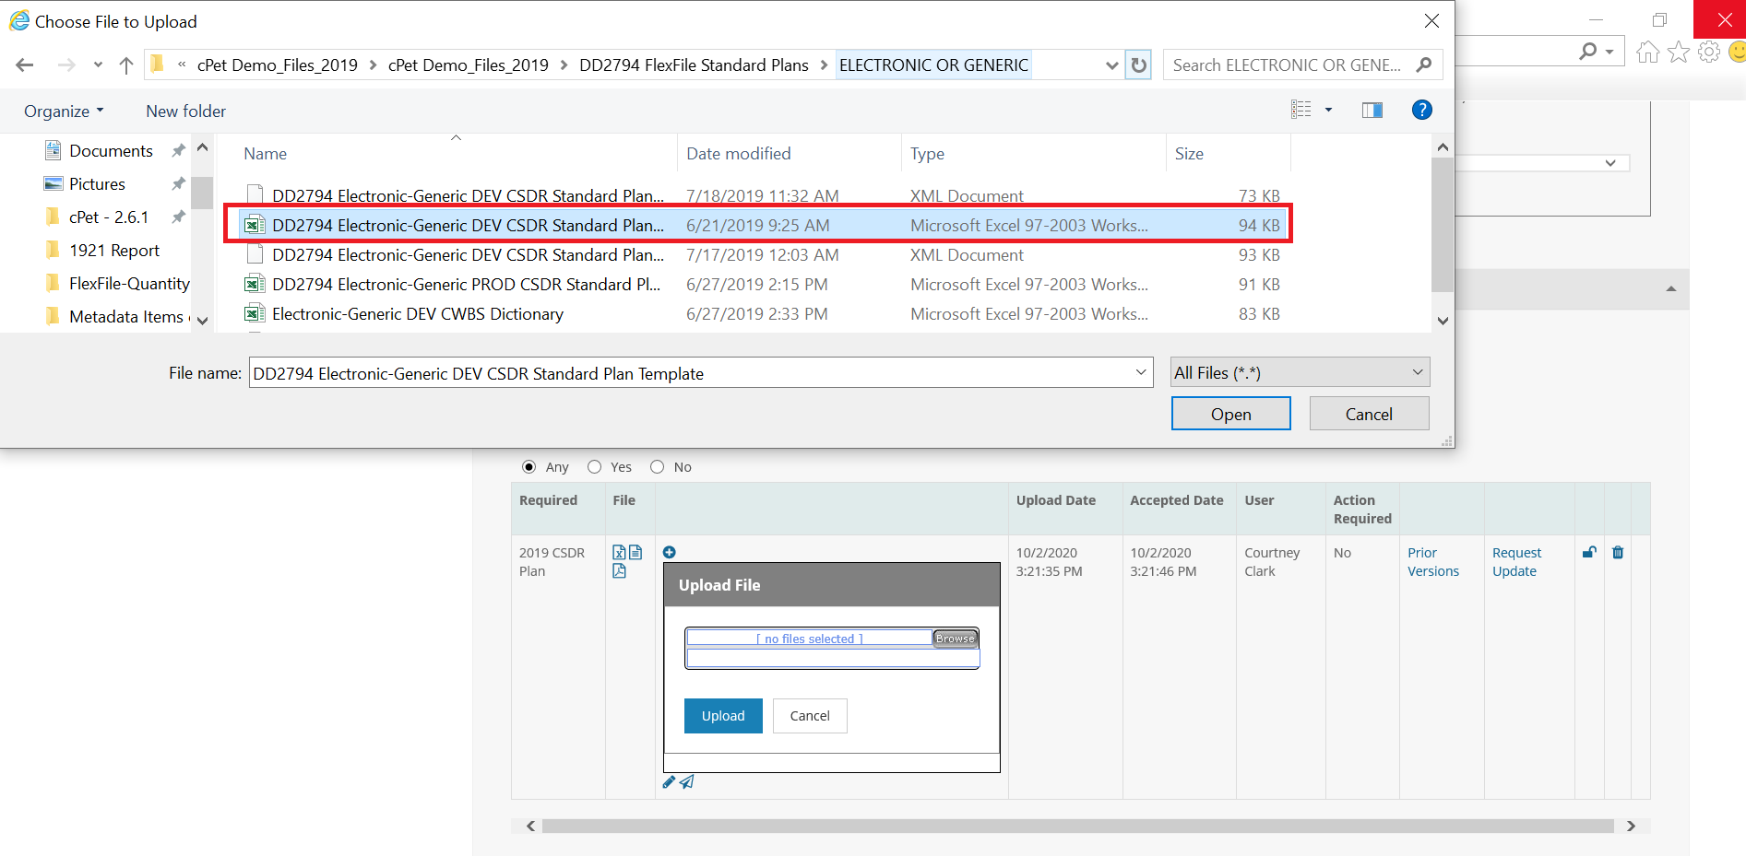
Tips & Tricks for Planning Process in the CADE System
Uploading in the PPM
  When uploading the plan in the PPM, if there is Tech Data be sure to upload the XLSX version of the plan in order to have the Technical Data Requirements attached

Slide 48
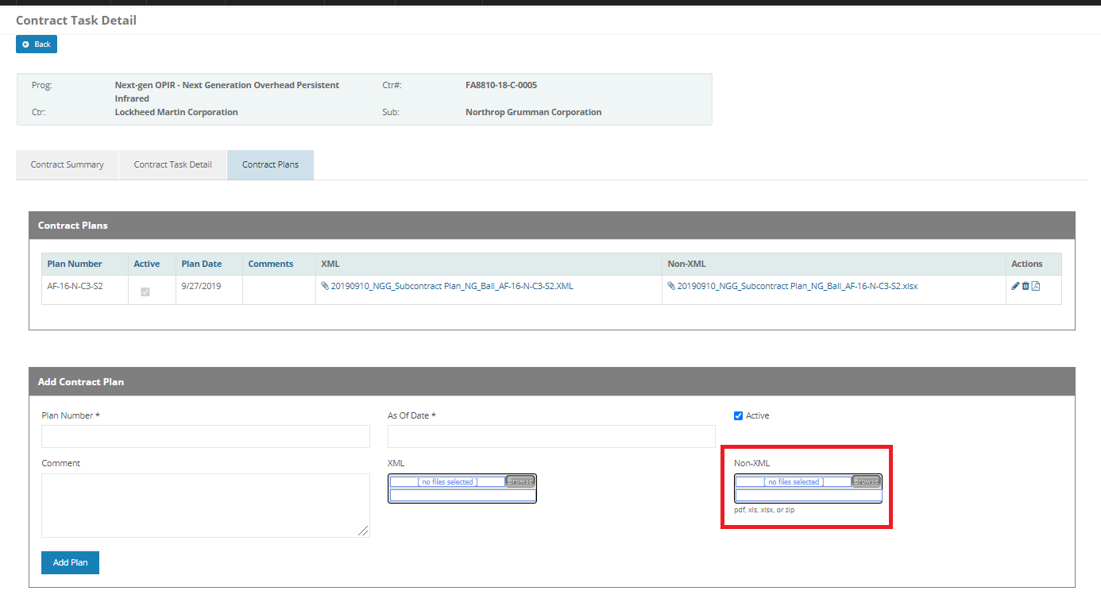
Tips & Tricks for Planning Process in the CADE System
Posting in the CSDR-SR
  In order to get the plan in the CSDR-SR with the Technical Data Supplement attached you must upload the Excel Version in the CSDR-SR
    The XML posts into the CSDR-SR from the PPM and because the XML does not have the Technical Data Supplement we need to ensure that the Excel is uploaded into the CSDR-SR separately

Slide 49
Technical Data Reporting Implementation
Intersection With Other Reporting

Slide 50
Technical Data Reporting Implementation
Intersection of Technical Data Reporting and Maintenance and Repair Data
Applicable to Sustainment contracts and Production contracts with Interim Contractor Logistics Support.
Include BOTH TDR and M/R on the CSDR plan
When Maintenance and Repair Reporting is planned, plan the Technical Data Report to capture information on the fielded item being supported such as fleet size and OPTEMPO.

Slide 51
Technical Data Reporting Implementation
Intersection of Technical Data Reporting and SRDR
Software (non-SRDR)
Reused Code
Carryover Code
Auto-generated code
Software Language
Product Size - Delivered
Product Size - Effective
ESLOC Equation
New Code
Modified Code
Development Process
Language
Product Size
Application Domain
Software Drops
Software Drop Frequency
Software Support
Software Changes
Software Support – FTEs
Software Detail
Autocode SLOC Conversion Factors
Software Development Standard
Software Effort Allocation Factors
Software Heritage Factors
Software Platform
Software Productivity Rule-of-Thumb Rates
Software Reliability Spec Level
Software Security Requirements
Software Target Security Rqmts
Software Test Level
When SRDRs are planned for a contract, additional Technical Parameters on Software WBS elements are not needed.
However, when SRDRs are not planned but the contract has Software content, consider a Technical Data Report to obtain minimum essential software parameters.

Slide 52
Technical Data Reporting Implementation
Intersection of Technical Data Reporting and CARD
A Tech Data Report pertains to a contract; A CARD pertains to an entire program life cycle.
An early CARD will contain the Government's forecast prior to delivery of a contract Tech Data Report
A Program Office may use the Tech Data Report to satisfy or augment their CARD requirements after a Tech Data Report is obtained.
CARD captures a subset of total requirements – primarily a program office point of view.
Total Cost Community Requirements
Program& Mile-stones
Roles
Contract
Time Phased Quantity
Time Phased Manpower
PMP Hardware Technical Data, SWAP, Heritage
Non-PMP Technical Data
O&S
O&S Detail
Software Detail
Cost
Technical Data Report
M/R
SRDR
FlexFile
CDRLs capture a subset of total requirements
- Primarily a contractor’s point of view

Slide 53
Technical Data Reporting Implementation
Technical Data Vocabulary Utility
Introduction and Overview

Slide 54
Technical Data Webinar
Demo of the Utility to Create the Technical Data Supplement
What is the Technical Data Utility: The Technical Data Utility is an excel workbook with VBA code intended to facilitate the creation of the Technical Data Supplement (Page 8).
What does the Technical Data Utility include:
The Technical Data Vocabulary
The Standard Plan Commodities with Item Types and Parameters identified for each WBS Element

Slide 55
Technical Data Reporting Implementation
Grouped Parameters Create Item Types and SubTypes
Space 1.2.2.7 TT&C
  Volume
  Weight
  Weight - Structural
  Weight - Electronics
  Power - Max Consumption Rate
  Technology Readiness Level (TRL)
  Percent New Design
  Predecessor System
  Part Number
  Manufacturer
  Number of Unique Designs - Application Specific Integrated Circuit (ASIC)
  Uplink Modes
  Data Rate - Average Downlink
  Data Rate - Average Uplink
  Data Rate - Maximum Downlink
  Data Rate - Maximum Uplink
  Memory - Data Storage Capacity
Missile 1.1.4.4.2 Transmitter
  Volume
  Weight
  Weight - Structural
  Weight - Electronics
  Power - Max Consumption Rate
  Technology Readiness Level (TRL)
  Percent New Design
  Predecessor System
  Part Number
  Manufacturer
  Transmitter Power Output - Peak
  Transmitter Power Output - Average
  Beam width
  Sensitivity - Seeker
  Noise Figure - Receiver
  Number of Oscillators
  Impedance
C4I Electronics 1.1.1.2 Amplifier
  Volume
  Weight
  Weight - Structural
  Weight - Electronics
  Power - Max Consumption Rate
  Technology Readiness Level (TRL)
  Percent New Design
  Predecessor System
  Part Number
  Manufacturer
  Gain
  Bandwidth
  Efficiency
  Slew Rate
  Frequency – Max
  Frequency – Min
  Amplifier Efficiency
  Amplifier Type
PhysicalElec
Common Subtypes are applicable across many commodities and WBS elements
Heritage
Identification
TT&C
TransRecRF
Amplifier
Unique Item Types Subtypes are applicable to few commodities or few WBS elements
Item Types are Unique to a Type of WBS Element
Subtypes are Common to Many WBS Elements

Slide 56
Technical Data Reporting Implementation
Vocabulary File Overview
The CADE Technical Vocabulary is comprised of two parts.
A glossary of parameter names, units, and definitions organized by Item Type
Commodity Work Breakdown Structures with associated Item Types
Item Type
Parameter Name
CSDR Standard Plan WBS
Item Types
Vocabulary Sheet
Commodity WBS Sheets

Slide 57
Technical Data Reporting Implementation
Creating Your Tech Data Plan (1 of 2)
To tailor a specific contract Tech Data Plan.
Insert your contract WBS onto a Commodity WBS sheet and designate Item Types by WBS element
  Copy the WBS Commodity worksheet most similar to your Contract WBS and rename the worksheet.
  Edit WBS Columns B and C to Match your Contract WBS.
  Edit Item Types (Columns E-R, as needed) to match the content of each WBS element.

Slide 58
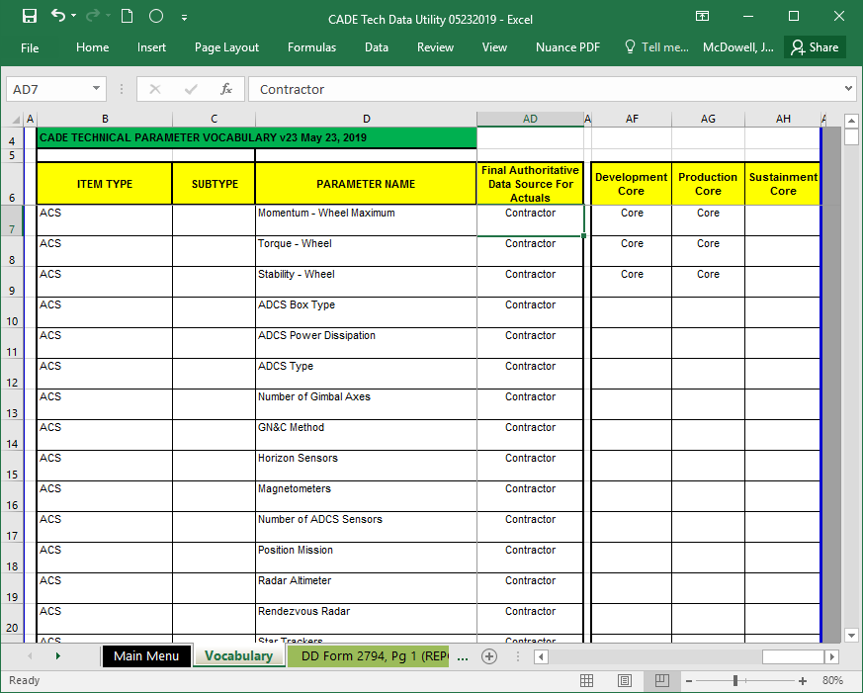
Technical Data Reporting Implementation
Creating Your Tech Data Plan (2 of 2)
To tailor a specific contract Tech Data Plan (cont.)
2. Edit parameters as needed for each Item Type.
  2a. Navigate to the Vocabulary worksheet.
  2b. In column AF-AH for your phase, the rows with “Core” will be placed onto your TDR plan. Edit as desired.
  2c. Insert rows and add additional parameters if desired.
  2d. In column AD verify all of your Core selections are also designated as Contractor.
    - copy parameters from other item types if applicable
    - if inserting entirely new parameters then ensure name, units, and definition are complete.
  2e. Save file using a new filename.

Slide 59
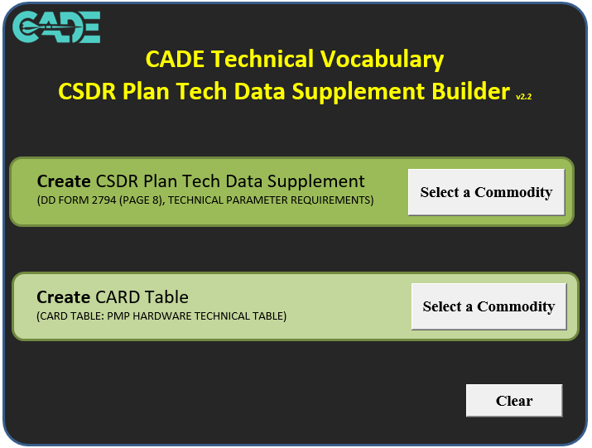

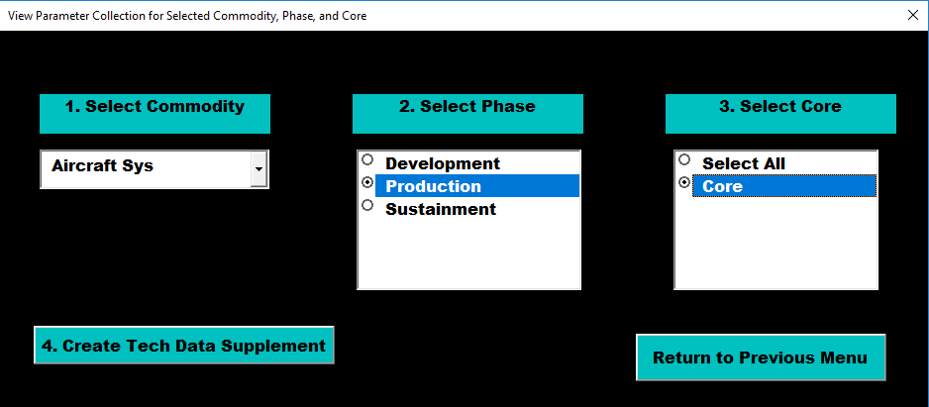
Technical Data Reporting Implementation
Generating Your Tech Data Plan
Go to Main Menu Sheet.
Press Select a Commodity button on the Create CSDR Plan Tech Data Supplement box.
3. Select the commodity.
4. Select Phase.
5. Select Core (unless you want everything imaginable on your Tech Data Plan)
6. Press Create Tech Data Supplement

Slide 60
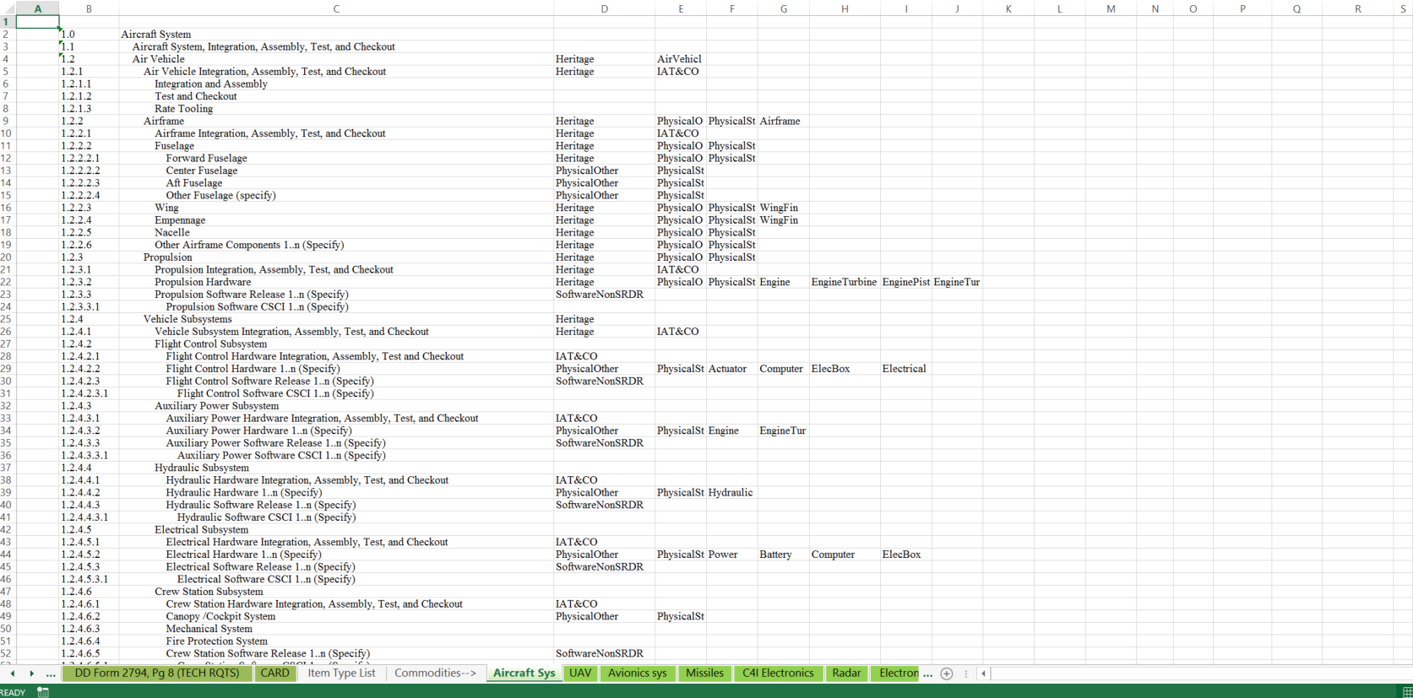
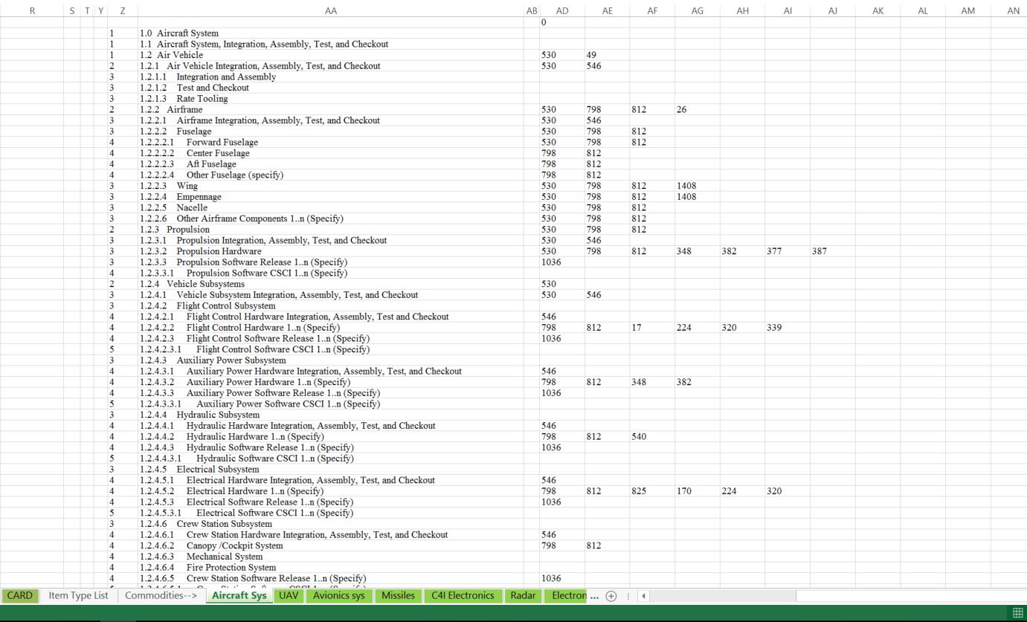
Technical Data Reporting Implementation
Things to Note:
When generating the Tech Data plan, the macro will hide all of the worksheets used to create the Tech Data plan. If you would like to create or edit a previously created Tech Data plan make sure to unhide all of the worksheets using the macro “UnHideAllWorkSheets”
When you create a new worksheet with for a new WBS structure, the name of the worksheet will populate in the drop down “1. Commodity”
Make sure that when updating the item type and WBS elements on the commodity worksheet you created, that the corresponding formulas are updated as well. Columns Z – AN pictured below.
Cells in columns AB – AN are used to verify the Item Type has been spelled correctly and is indeed on the Vocabulary sheet. When cell AB1 shows a zero you are good to go.

Slide 61
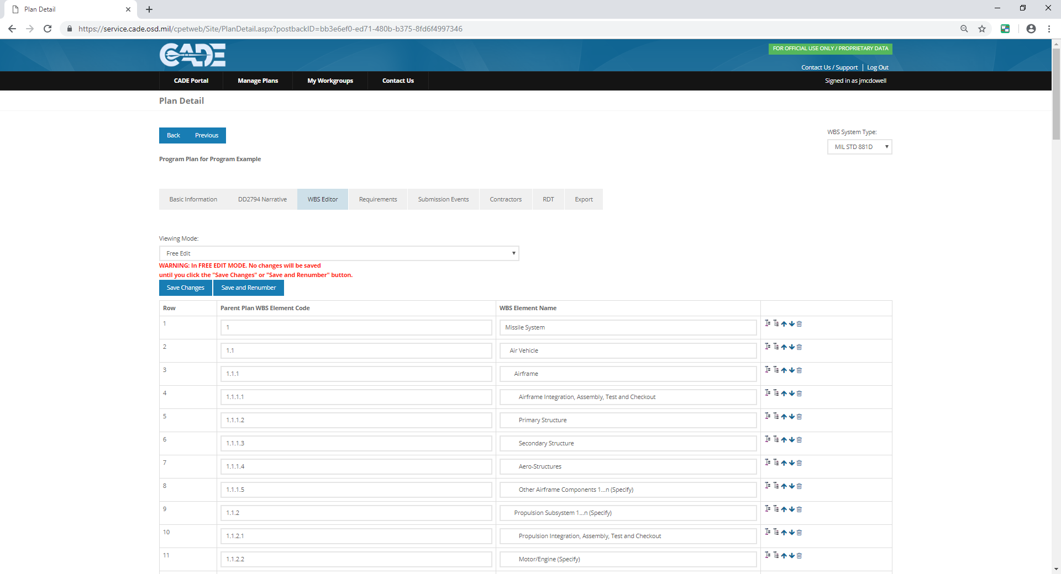

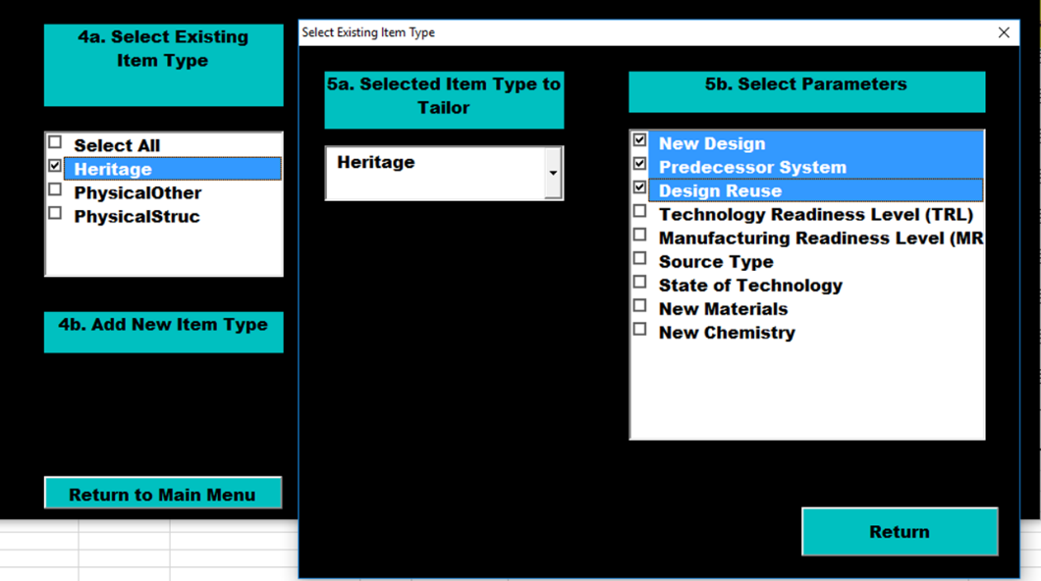
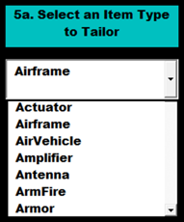

Technical Data Reporting Implementation
Future cPET Features
Tech Data Supplement
The functionality of this utility is anticipated in a future version of cPET.

Slide 62
Technical Data Reporting Implementation
DD 2794 Overview

Slide 63
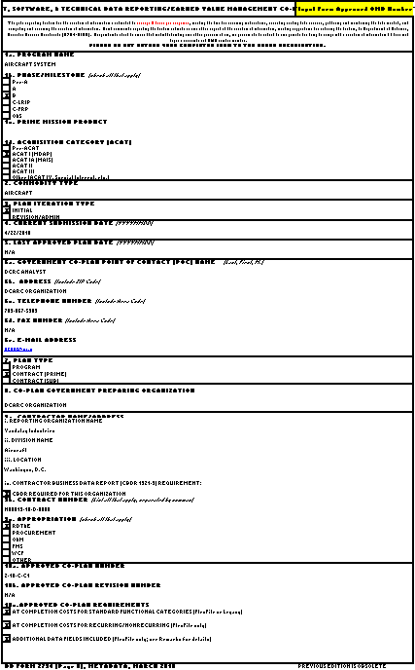
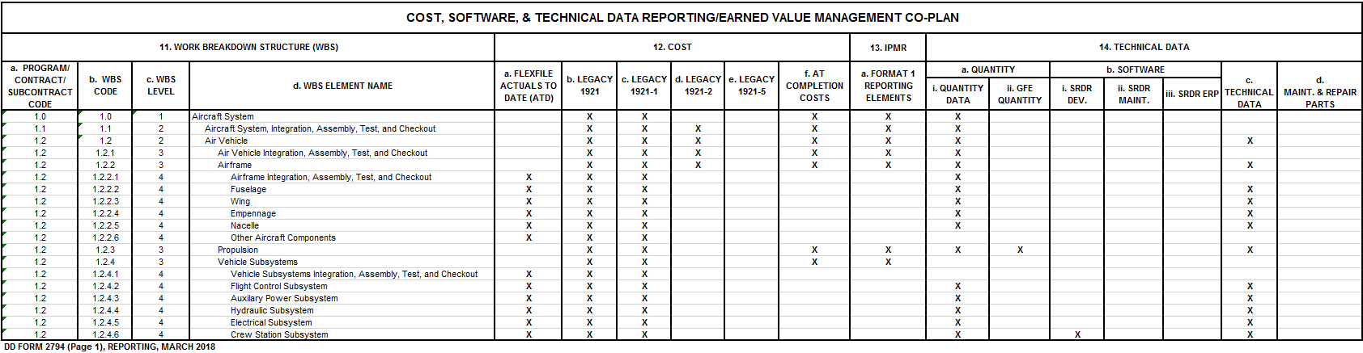
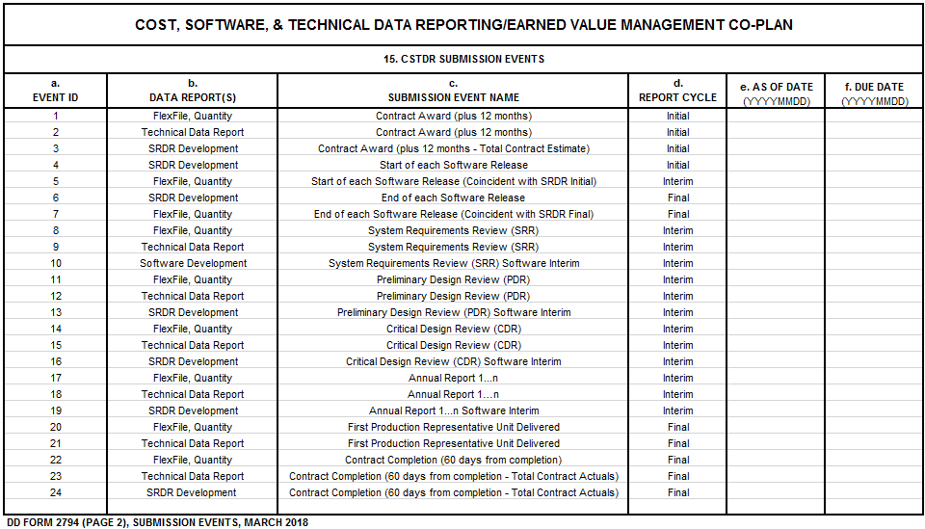
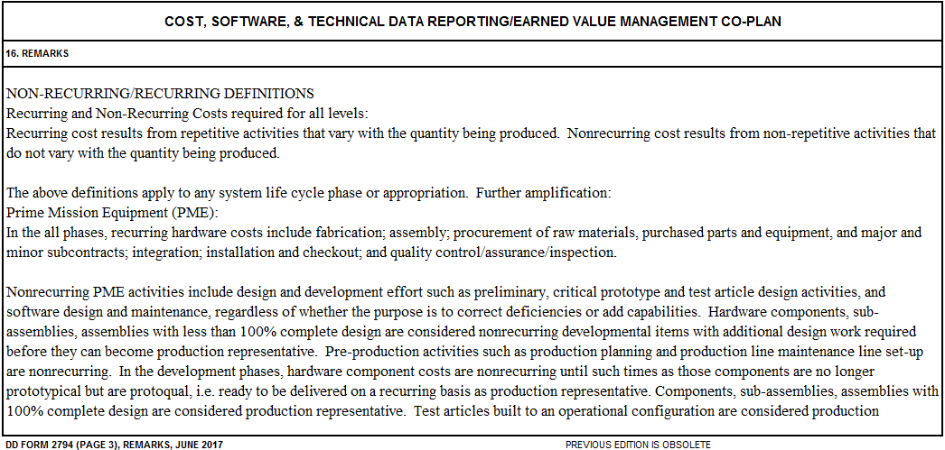
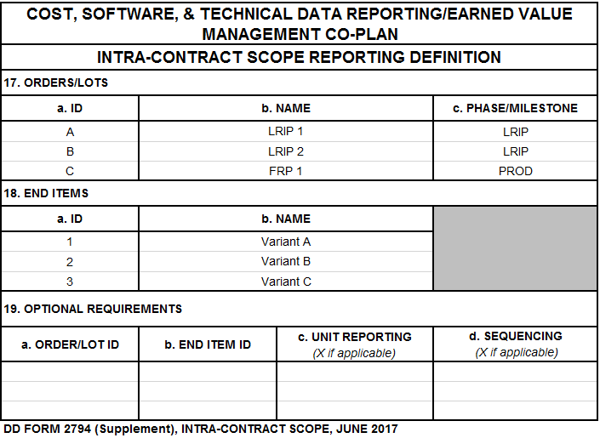
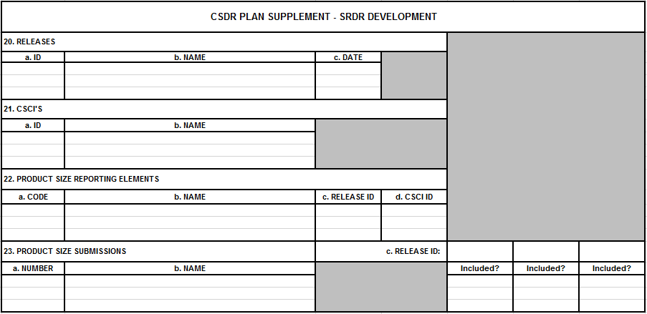
Technical Data Reporting Implementation
New DD 2794
METADATA
REPORTING SUMMARY
Legacy 1921 & SRDR
METADATA
REPORTING SUMMARY
SUBMISSION EVENTS
REMARKS
SRDR SUPPLEMENT
SUBMISSION EVENTS
REMARKS
FlexFile & Technical & SRDR
METADATA
REPORTING SUMMARY
SUBMISSION EVENTS
REMARKS
SCOPE DEFINITION
SRDR SUPPLEMENTS
TECHNICAL DATA SUPPLEMENT
+ SCOPE DEFINITION
+ TECHNCIAL DATA SUPPLEMENT
+ SRDR SUPPLEMENTS

Slide 64
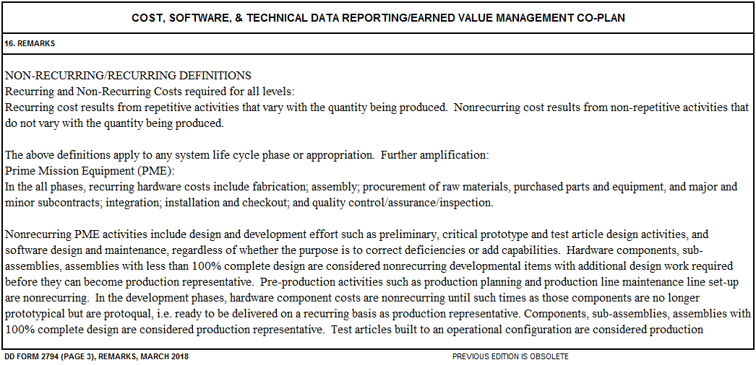
Technical Data Reporting Implementation
Remarks
Remarks:
Standard plan language will be leveraged
Variant and submission instructions no longer applicable for FlexFile implementation
May contain post-award revisions to specify additional contractor reported fields in FlexFile submission

Slide 65
Technical Data Reporting Implementation
Prime Reporting of Subcontracted Items
Are primes responsible for reporting technical parameters for subcontractors/suppliers?
Direct Reporting Subcontractors
(Contract Value > $50M)
Material Supplier/Non-Reporting Subcontractor
(Contract Value < $20M)
Prime flows reporting requirements down to subcontractors
Prime contractor collects technical data from supplier/subcontractor
Subcontractor submits Technical Data directly to DCARC
Prime contractor submits Technical Data directly to DCARC

Slide 66
Technical Data Reporting Implementation
Treatment of Variants

Slide 67
Technical Data Reporting Implementation
Treatment of Multiple Variants
Weak
When reporting multiple variants, use Mapping ID to avoid repetition of common parameter values.
Example two variants differing only in Mission LRU.
5.3.1 Mapping ID: By hardware item, a unique identifier by Item Type for each individual group of parameters. Unique identifiers are used only when reporting common parameters across multiple variants is desired. Otherwise the WBS Element Code may be repeated here and used as the Mapping ID. Created by the reporting organization, the Mapping ID is any unique alpha-numeric code that is used to differentiate between individual parts. This is used to match the technical parameters to the End Item ID and corresponding WBS element code in the “Technical Data WBS Mapping ID” table, Data Group D (Mapping ID) of the Technical Data Report. If there is only one identified End Item and Order Name, the reporting organization may use the WBS element code as the Mapping ID.
Better

Slide 68

Technical Data Reporting Implementation
Use of Group Key Example
5.3.4 Group Key
  The Group Key indicator is used to keep like-rows together. This is necessary when a WBS element has repeated subsets of the same parameters.
Example: LRU (a WBS element) comprised of three cards (not WBS elements). Used to keep each card’s parameters together.

Slide 69
Technical Data Reporting Implementation
Mapping ID & Lot Reporting
5.4.1 Mapping ID
  By hardware item, a unique identifier by Item Type for each individual group of parameters. Unique identifiers are used only when reporting common parameters across multiple variants is desired. Mapping ID for Item Types which uniquely identify the corresponding Order Name (Lot 1, Lot 2, Lot 3, etc.) and End Item (Model, Version, Flight, Variant, or equivalent grouping or variant of a reported unit or system).

Slide 70
Technical Data Reporting Implementation
Planning, Tailoring, and Reporting Using
Temporal Examples of Both CARD and TDR

Slide 71
Technical Data Reporting Implementation
An Example Aircraft Program WBS with Item Types
WBS Code
WBS Element Name
Item Type
1.0
1.1
1.1.1
1.1.1.1
1.1.1.2
1.1.2
1.1.3
XYZ System
BR549 Aircraft
Electronic Systems
LRU Navigation
LRU Mission
Airframe
Engine
AirVehicle
Avionics
Navigation
ElecBox
Airframe
EngineTurbine
Example will focus on this WBS element
Item Type Modularizes Data

Slide 72
Technical Data Reporting Implementation
Technical Vocabulary Comprised of Item Types
Program WBS
Standard WBS
Common Subtypes
Unique Items Types

Slide 73

Technical Data Reporting Implementation
CWIPT’s Use of the Technical Vocabulary
PO Office
OSD CAPE
Is this needed for this Phase?
Is this a typically Contractor determined value?
Will this value be available at the submission event?
Is this value available from another source?
Service Cost
SYSCOM
CWIPT
Service EV
PARCA
L&MR
DCARC
CWIPT Uses Tech Vocabulary to Tailor each Co-Plan

Slide 74

Technical Data Reporting Implementation
Example CARDs and TDRs in EMD
Annual CARDs
MS B CARD
MS C CARD
TDR Submission Event 1
TDR Submission Event 2
TDR Submission Event 3
Development Contract
TDR
Submissions:
CDR
First Delivery
Contract End
End Item WBS Elements Tech Data:
BR549 Aircraft
Estimates
Actuals
In This Example, EMD’s Time Span Envelopes Three TDR Submissions by the Contractor and Multiple CARD Submissions by the PM

Slide 75
Technical Data Reporting Implementation
Example MS B CARD
Assessing TRL is an inherently Government function. Will not be on the TDR.
Low and High values often in early CARDs but TDR contains point estimates.
Few actuals in early CARDs.
Objective/ Threshold stated at high levels of the WBS.
Government Ref Architecture documents and Government SMEs cited.

Slide 76
Technical Data Reporting Implementation
Technical Data Reporting Supplement
Finalize Technical Data Reporting, DD 2794 Supplement & Submission Event Schedule
CWIPT process will derive contract data plan and analyze the following questions regarding the Parameters
  Can the requirement be satisfied by GOVT CARD?
  Can the requirement be satisfied by other Program CDRL?
  Can the requirement be satisfied by other reputable data sources?
PO Office
OSD CAPE
Service Cost
SYSCOM
CWIPT
Service EV
PARCA
L&MR
DCARC

Slide 77
Technical Data Reporting Implementation
Example TDR Submission #1 CDR
Reported values.
Many estimated values at this event.
Enter any information that would explain any peculiarities or ambiguities in any of the data reported.

Slide 78
Technical Data Reporting Implementation
Example TDR Submission #2 First Delivery
Tighter measured values. More significant digits.
Many actual values at this event.
Margin consumed since Submission #1

Slide 79
Technical Data Reporting Implementation
Example MS C CARD
Low and High values sparse in later CARDs.
More actuals in later CARDs.
TDR cited as source in many cases.

Slide 80






Technical Data Reporting Implementation
Example Database
Vandalay Industries
BR-549 Aircraft WXXXX-17-C-000X Vandalay
Filter
WBS Element
1.1 Air Vehicle
Item Type
Air Vehicle
Parameter
Weight
Unit of Measure
Pounds

Slide 81

Technical Data Reporting Implementation
Example Parameter Over Time Chart
Vandalay Industries
BR-549 Aircraft WXXXX-17-C-000X Vandalay
Filter
WBS Element
1.1 Air Vehicle
Item Type
Air Vehicle
Parameter
Weight
Unit of Measure
Pounds

Slide 82
Technical Data Reporting Implementation
Treatment of Margin and Data Pedigree

Slide 83
Technical Data Reporting Implementation
Margin
Margin 5.3.9
  The estimated or measured margin for the associated Technical Parameter specified by the Mapping ID. The margin value may be reported anytime the parameter is routinely expressed as a single planned value plus some amount of design margin or growth allowance. Margin is expressed in the same units as the parameter value – not as a percentage.
Value 2150
Margin 200
An item may have a planned value of 2150 lbs with a contingency of an additional 200 lbs of growth allowance. This would be expressed with a Value=2150; Margin=200; and Unit of Measure="Pounds." Do not enter a percent.

Slide 84
Technical Data Reporting Implementation
Estimate vs. Actual
5.3.8 Estimate vs. Actual
  For each parameter value, “Estimate” or “Actual” shall be reported for the most representative valuation of the “pedigree” or derivation of the technical parameter values reported (DID reference 5.3.8)
Estimate
Threshold Value
Spec Value
Actual
Measured Value
Known Value

